Slide 1

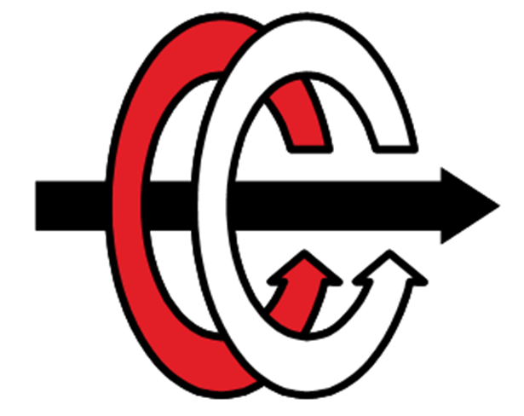
EE463-Term Project Kardeşler Elektronik A.Ş.
#since1998
Emin Ün 2167476
Enes Canbolat 2231546
Berkay Uzun 2263812

Slide 2
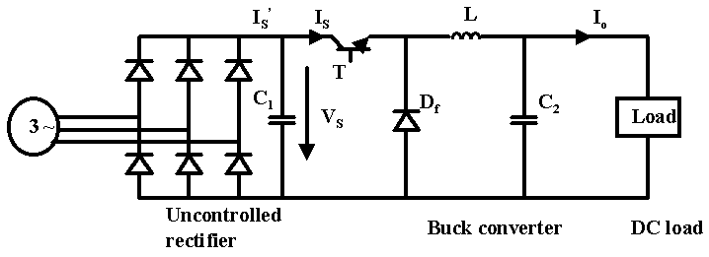
TOPOLOGY SELECTION

Slide 3
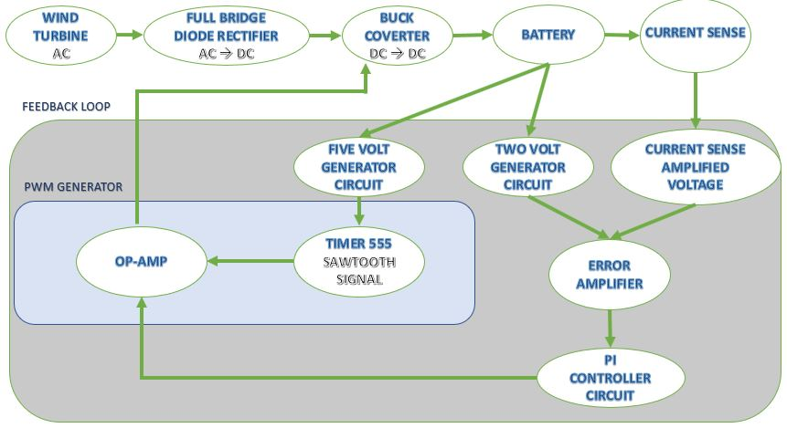
CIRCUIT DESIGN AND SIMULATION RESULTS

Slide 4
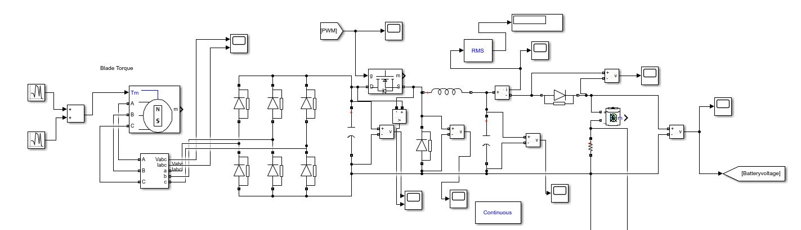
CIRCUIT DESIGN AND SIMULATION RESULTS

Slide 5
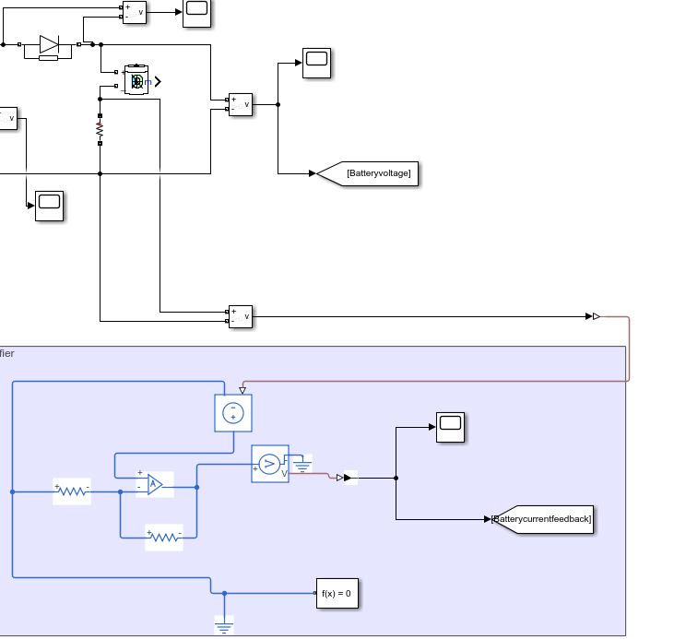
CIRCUIT DESIGN AND SIMULATION RESULTS

Slide 6
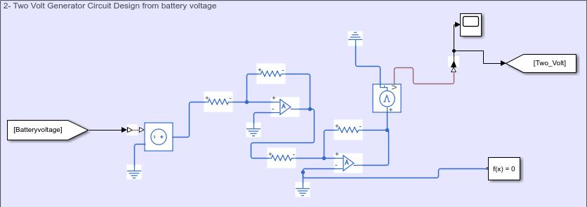
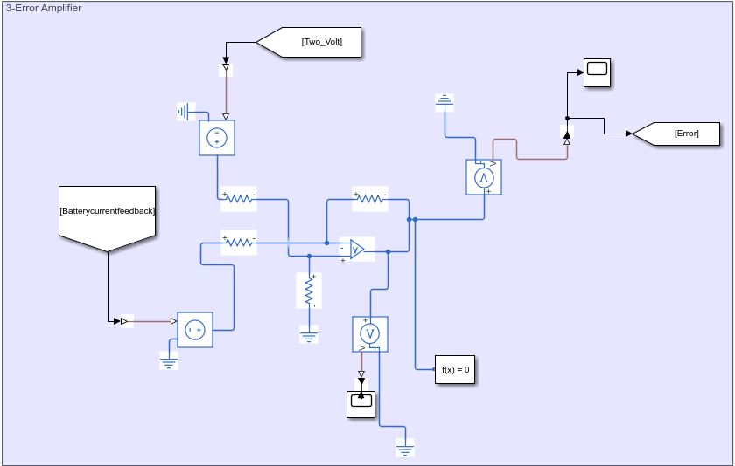
CIRCUIT DESIGN AND SIMULATION RESULTS

Slide 7
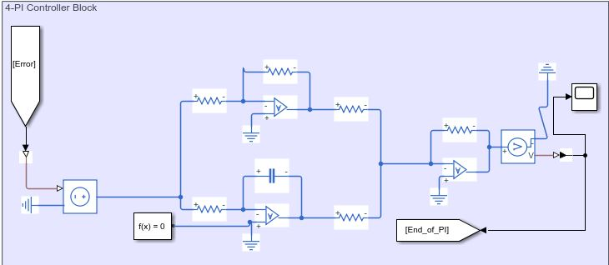
CIRCUIT DESIGN AND SIMULATION RESULTS

Slide 8
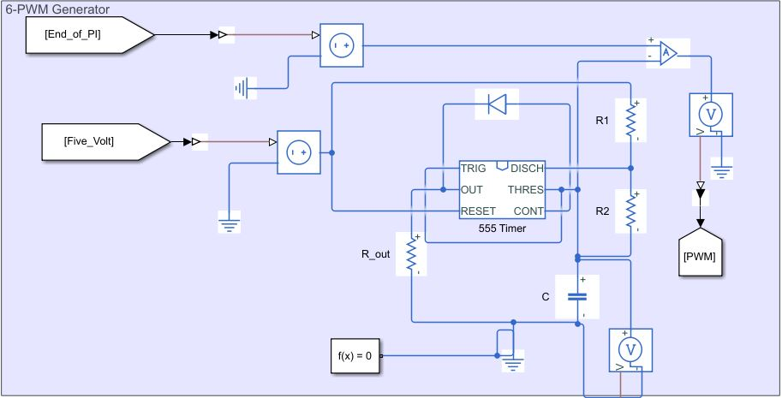
CIRCUIT DESIGN AND SIMULATION RESULTS

Slide 9
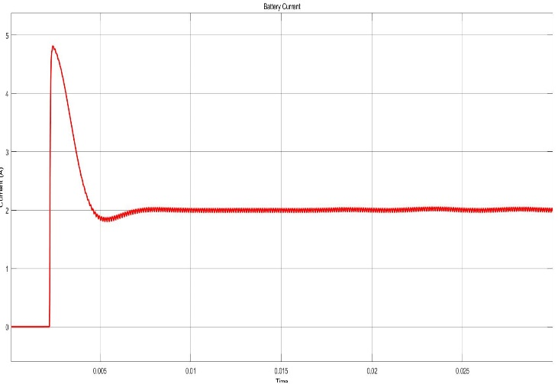
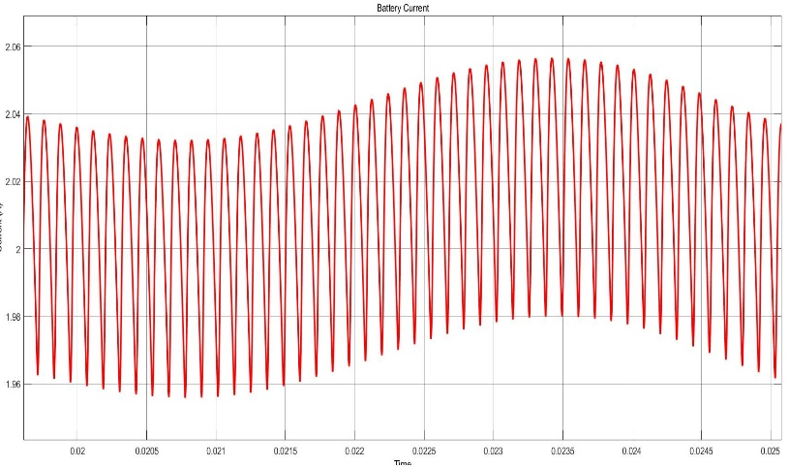
CIRCUIT DESIGN AND SIMULATION RESULTS

Slide 10
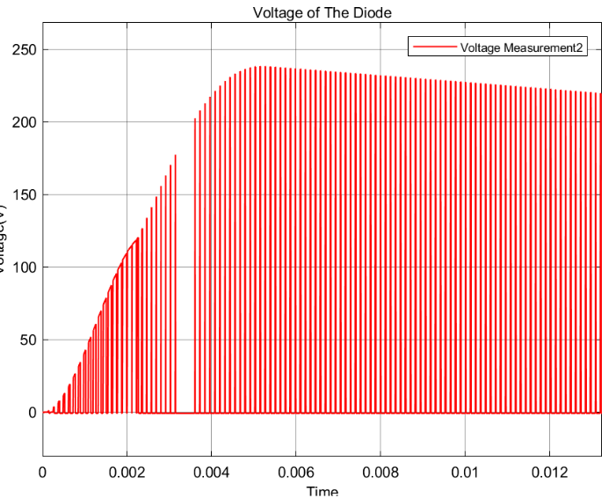
COMPONENT SELECTION
MOSFET Selection
Diode Selection

Slide 11
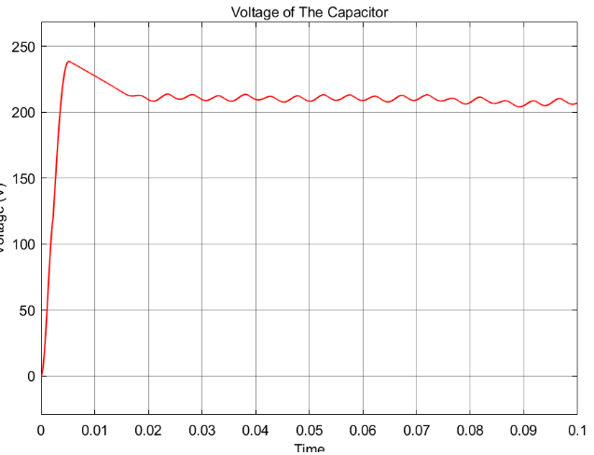
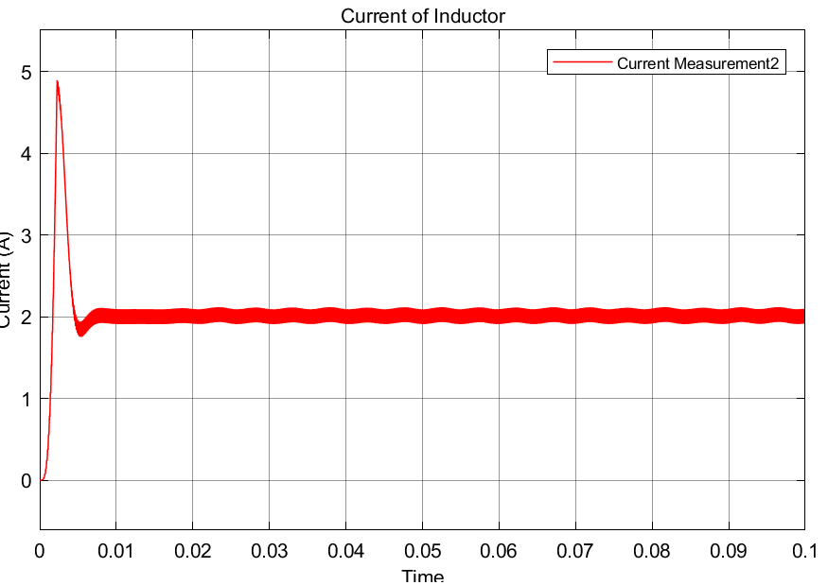
COMPONENT SELECTION
Capacitor Selection Inductor Selection

Slide 12
COST ANALYSIS
Component | Rated Value | Place in the Circuit | Type of the Component | Manufacturer | Serial Number | Cost ($)
Resistors (Ω) | 0,25 | Current Sense | Chip Resistor - Surface Mount | Venkel | LCR0603-R250FT | 0.03062
 | 1k | 2 Volt Generator | CARBON FILM RESISTOR | KOA Speer Electronics, Inc. | CF1/4C102J | 0.10000
 | 5.1k |  | CARBON FILM RESISTOR | KOA Speer Electronics, Inc. | CFS1/4CT52R512J | 0.10000
 |  |  | CARBON FILM RESISTOR | KOA Speer Electronics, Inc. | CFS1/4CT52R512J | 0.10000
 | 12k |  | CARBON FILM RESISTOR | KOA Speer Electronics, Inc. | CF1/4CT52R123J | 0.10000
 | 560 | 5 Volt Generator | CARBON FILM RESISTOR | KOA Speer Electronics, Inc. | CF1/2CT52R561J | 0.11000
 | 2.7k |  | CARBON FILM RESISTOR | KOA Speer Electronics, Inc. | CF1/2CT52R272J | 0.11000
 | 5.1k |  | CARBON FILM RESISTOR | KOA Speer Electronics, Inc. | CFS1/4CT52R512J | 0.10000
 |  |  | CARBON FILM RESISTOR | KOA Speer Electronics, Inc. | CFS1/4CT52R512J | 0.10000
 | 240 | Amplifier | CARBON FILM RESISTOR | KOA Speer Electronics, Inc. | CF1/2CT52R241J | 0.11000
 | 1.2k |  | CARBON FILM RESISTOR | KOA Speer Electronics, Inc. | CF1/4CT52R122J | 0.10000
 | 1.2k | Error Amplifier | CARBON FILM RESISTOR | KOA Speer Electronics, Inc. | CF1/4CT52R122J | 0.10000
 | 3.3k |  | CARBON FILM RESISTOR | KOA Speer Electronics, Inc. | CF1/4CT52R332J | 0.10000
 | 5.1k |  | CARBON FILM RESISTOR | KOA Speer Electronics, Inc. | CFS1/4CT52R512J | 0.10000
 |  |  | CARBON FILM RESISTOR | KOA Speer Electronics, Inc. | CFS1/4CT52R512J | 0.10000
 | 680 | PI Controller | CARBON FILM RESISTOR | KOA Speer Electronics, Inc. | CFS1/4CT52R681J | 0.10000
 | 820 |  | CARBON FILM RESISTOR | KOA Speer Electronics, Inc. | CF1/2CT52R821J | 0.11000
 |  |  | CARBON FILM RESISTOR | KOA Speer Electronics, Inc. | CF1/2CT52R821J | 0.11000
 | 2.2k |  | CARBON FILM RESISTOR | KOA Speer Electronics, Inc. | CF1/2CT52R222J | 0.11000
 |  |  | CARBON FILM RESISTOR | KOA Speer Electronics, Inc. | CF1/2CT52R222J | 0.11000
 | 5.6k |  | CARBON FILM RESISTOR | KOA Speer Electronics, Inc. | CF1/4CT52R562J | 0.10000
 | 1.2k | Timer | CARBON FILM RESISTOR | KOA Speer Electronics, Inc. | CFS1/4CT52R122J | 0.10000
 | 3.3k |  | CARBON FILM RESISTOR | KOA Speer Electronics, Inc. | CF1/4CT52R332J | 0.10000
 | 100k |  | CARBON FILM RESISTOR | KOA Speer Electronics, Inc. | CF1/2CT52R104J | 0.11000
Capacitors | 100µF | Buck Converter | Aluminum Electrolytic | Illinois Capacitor | 107RZM05 | 0,02856
 | 100µF | Filter | Aluminum Electrolytic | United Chemi-Con | EKXJ221ELL101MK25S | 0,71258
 | 1nF | Timer | Ceramic | Yageo | CC0100KRX5R4BB102 | 0,01475
Inductor | 15mH | Buck Converter | Fixed RING CORE CHOKE | EPCOS/TDK | 871-B82724J8302N040 | 5,9593
MOSFET | 240V (Max) 210V(Rated) 5A (Max) 2A (Rated) | Buck Converter | N-MOSFET | Infineon Technologies | 726-IPN70R360P7SAUMA | 0,92964
Diodes |  | Rectifier | Bridge Rectifier | Micro Commercial Components | 833-3GBJ3516-BP | 5,4778
 |  | Buck Converter | Schottky Diode | Wolfspeed / Cree | 941-C6D04065E | 0,89914
 |  | Before the battery | Schottky Diode | Vishay General Semiconductor | 78-V8PAM10S-M3/H | 0,4026
 |  | Timer | IC OSC SINGLE TIMER | Texas Instruments | 296-1857-5-ND | 0,84
OP-AMP (11) |  | Everywhere:) | Operational-Amplifier | NJR | 513-NJU7067M-TE2 | 1,62382
OP-AMP |  | Current Sense | Operational-Amplifier | Texas Instruments | 595-OPA2990IDDFR | 1,6592
 |  |  |  |  | Total Cost = | 18,54739

Slide 13
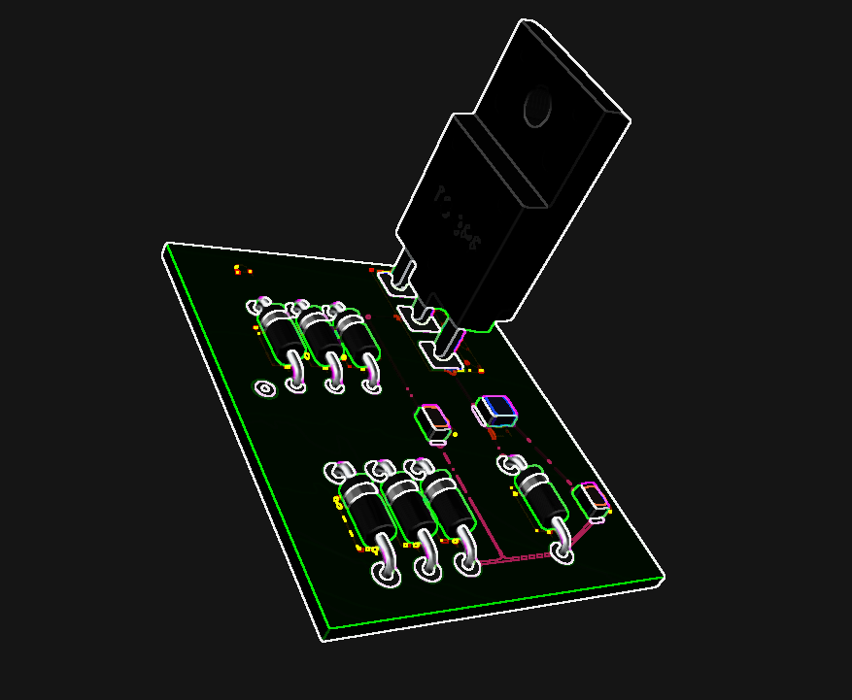
FUTURE PLANS
PCB Design
Minimizing the Circuit Design

